Slide 1










Chemical synthesis and self-assembly
of nanoparticles for plasmonics
Lise-Marie LACROIX
LPCNO – UPS, Toulouse
lmlacroi@insa-toulouse.fr
Erik DUJARDIN
CEMES - CNRS, Toulouse
dujardin@cemes.fr

Slide 2


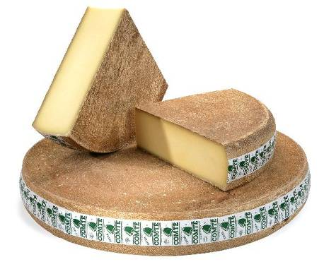
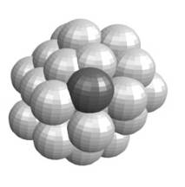
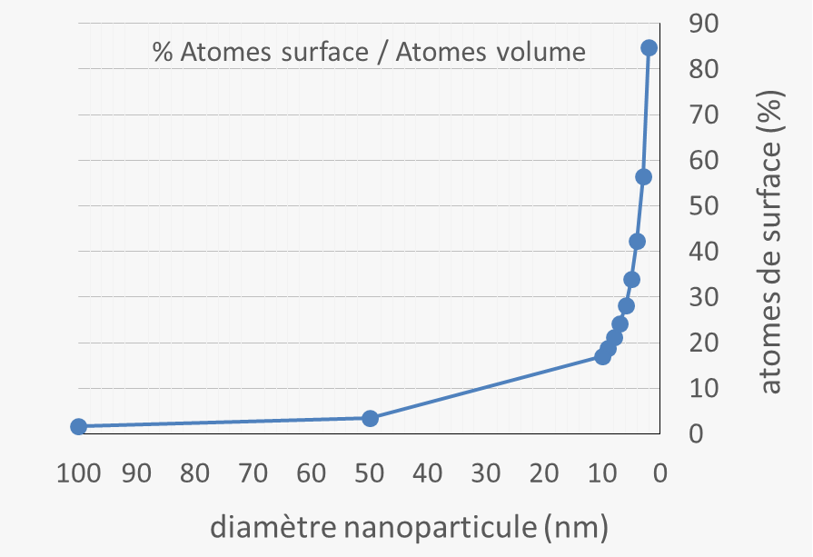
Nanoparticles - introduction
veimages.gsfc.nasa.gov
www.comté.com
10⁶ m
10³ m
1 m
10⁻² m
10⁻⁶ m
10⁻⁹ m
Ecole ETPMSE – 20/06/2016

Slide 3
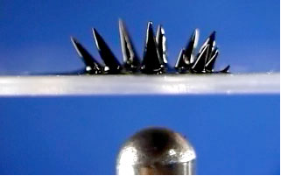
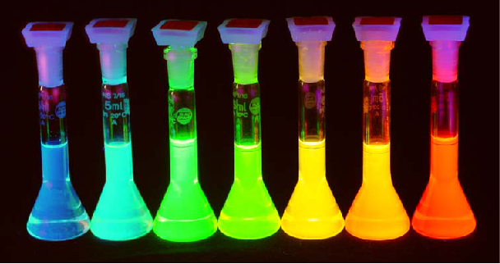
Nanoparticles - introduction
veimages.gsfc.nasa.gov
www.comté.com
10⁶ m
10³ m
1 m
10⁻² m
10⁻⁶ m
10⁻⁹ m
Nanoparticle : assembly of few thousands of atoms :
Unprecedented physical properties
Magnetism
Plasmonic
Luminescence
Ecole ETPMSE – 20/06/2016

Slide 4
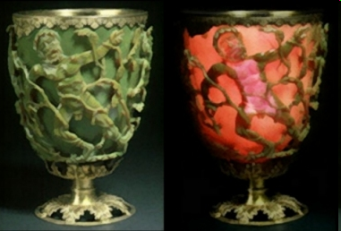
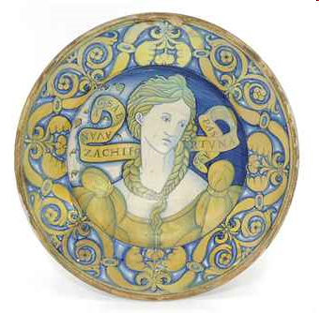

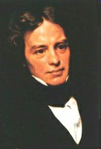
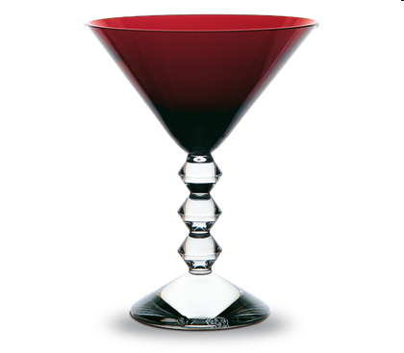
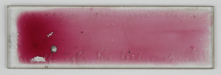
Plasmons in nanoparticles – a long history
Lycurgus cup :
(Au/Ag NPs)
Deruta dish :
(Cu/Ag NPs)
12-14th centuries
16th century
4th century
1857
1908
Slide that Faraday used in his lecture on gold sols, in 1858.
© Whipple Museum (Wh.0654)
Michael Faraday :
Synthesis and
optical properties of NPs
Collection Véga
Baccarat
Medieval stained glass :
Au NPs - red color

Slide 5
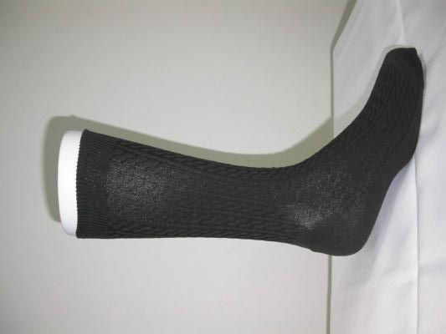
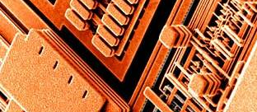
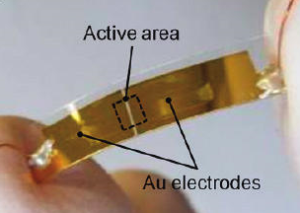
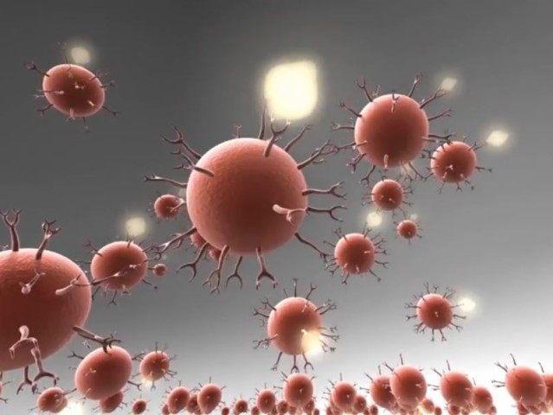
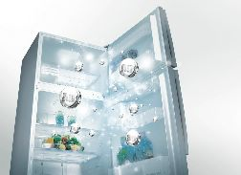
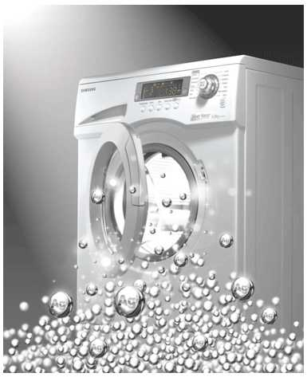
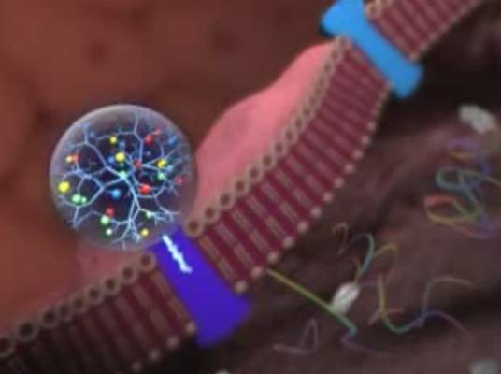
Nanoparticles – Present applications
Microelectronics
Gauges
Detection
Sensors
Treatment
Disque dur
Ecole ETPMSE – 20/06/2016

Slide 6
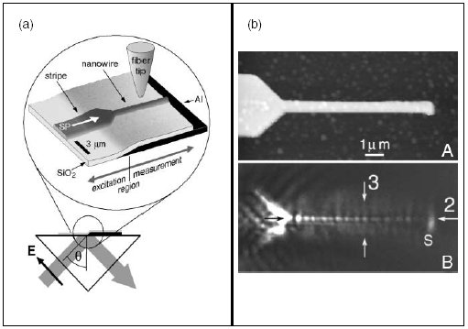
Challenges in top-down plasmonics …
Confinement.
Propagation & decay.
Interconnection.
S
λ
λ
λ
J. C. Weeber et al., PRB, 2001, 64, 045411
W. L. Barnes, et al., Nature, 2003, 424, 824
B Lamprecht et al., App. Phys. Lett., 2001, 79, 51
J. Krenn, et al., Europhys. Lett., 2002, 60, 663.
S. I. Bozhevolnyi, A. Dereux et al.,
Opt. Exp. 2009, 34, 310
Notes:
Plasmonics has emerged from the patterning of metal films, among other possible applications, in order to CONFINE, PROPAGATE and ROUTE surface plasmons beyond the diffraction linits of dielectric optics. While this was successfully demonstrated in 1-micron wide waveguides, it turned out to be very challenging to push it to real sub-wavelength devices. In particular surface roughness was creating dissipation channels which prevented long range propagation in narrow waveguide.

Slide 7
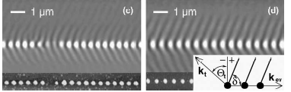
… meet assets in colloidal plasmonics
Pushing the resolution with LSP.
Using coupled particles to confine light
In less than 100 nm wide waveguides
M. Salerno, et al., Optics Commun., 2005, 248, 543.
Optical near-field results from the superposition of
- particle plasmon near field
- interference of incident and emitted fields
Loss in 50 nm dot separated by 75nm
3dB / 15 nm
Loss in 25 nm PERFECT dots separated by 75 nm
3dB / 500 nm
M. Salerno, et al., Optics Commun., 2005, 248, 543.
H. Ditlbacher, et al., Phys. Rev. Lett., 2005, 95, 257403.
Notes:
One trick was to replace continuous metal stripes by series on metal islands patterned by EBL. While this was successful to reduced the lateral dimensions of the waveguide, dissipation due to disorder and lack of cristallinity remained.
One experiment in 2005 was timely to show the assets of nanoparticles.
The performances of two Ag nanowires were compared, one done by EBL patterning of a metal film, the other one (of identical dimensions_ grown by colloidal chemistry. Injecting light in one end and monitoring the light scattered in the near-field showed that Fabry Perot cavity modes could be seen atop the crystallline nanowire but not on the rough and polycrystalline stripe.

Slide 8
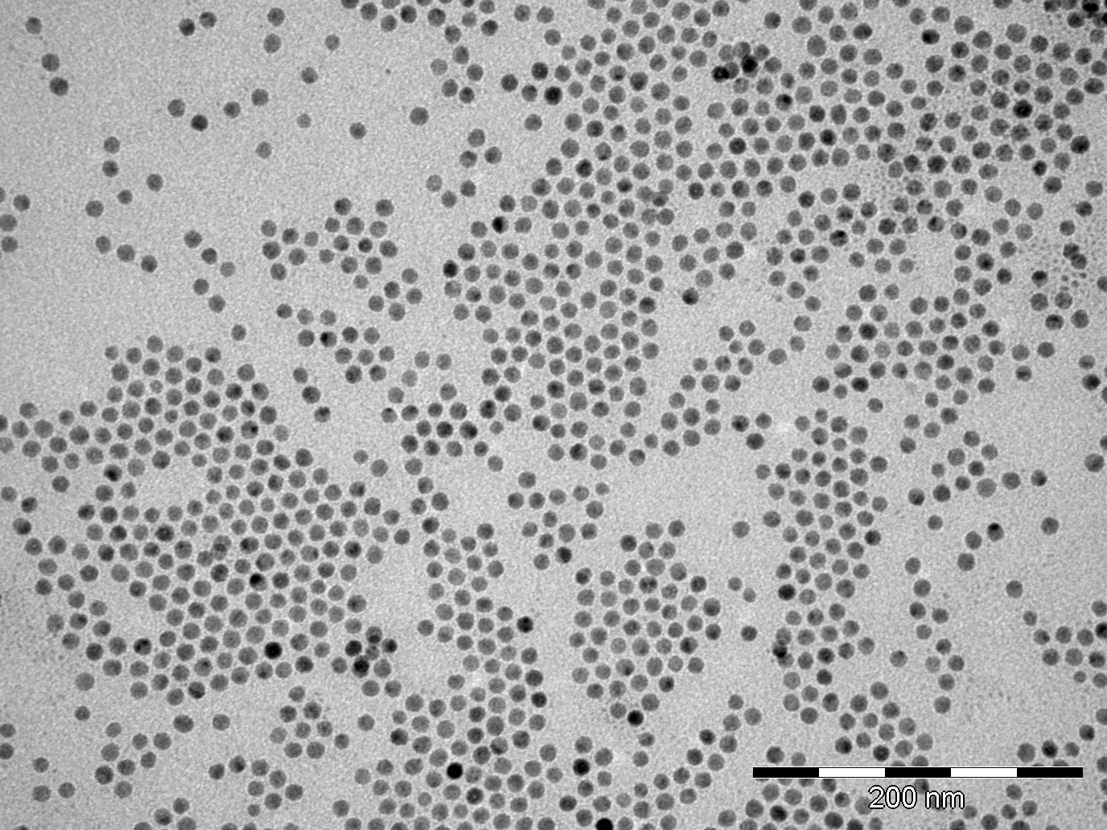
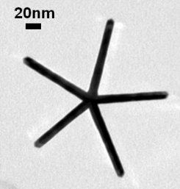
Nanoparticles : synthesis - applications
Chemical synthesis: brief overview
20 nm
Size and shape control
Controlled self-assemblies
Perspectives : hybrids nanoparticles
Ecole ETPMSE – 20/06/2016
Notes:
8

Slide 9
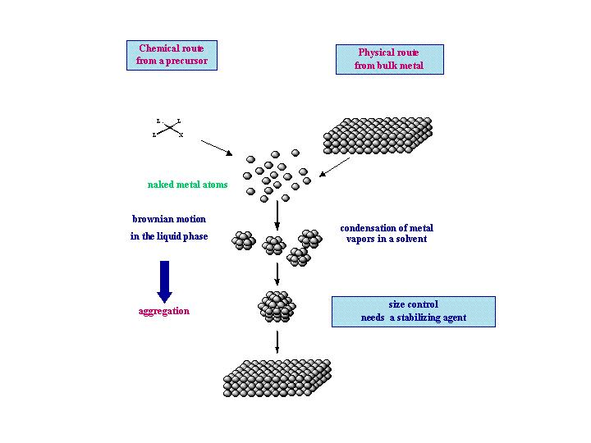
General strategy for NPs synthesis
“Chemical approach”
“Physical approach”
L
L
X
L
Nucleation
Liquid phase
Gas phase
Growth
Self-assembly / coalescence
Ecole ETPMSE – 20/06/2016

Slide 10
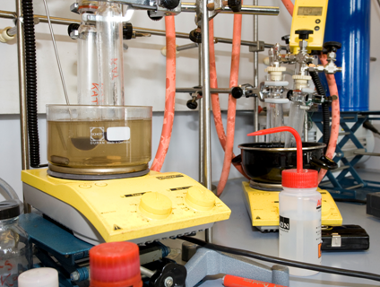
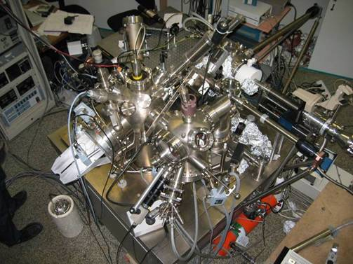
General strategy for NPs synthesis
“Chemical approach”
“Physical approach”
L
L
X
L
Relatively low cost
Ultra high vacuum set up.
Ecole ETPMSE – 20/06/2016

Slide 11

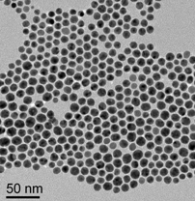
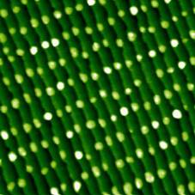
General strategy for NPs synthesis
“Chemical approach”
L
L
“Physical approach”
X
+
L
Surfactants
Liquid phase reaction :
colloidal solution
Ultra high vacuum reaction :
NP onto a substrate
60 nm
Ecole ETPMSE – 20/06/2016

Slide 12
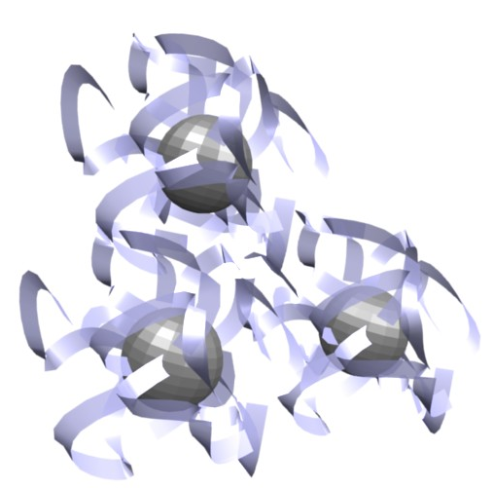
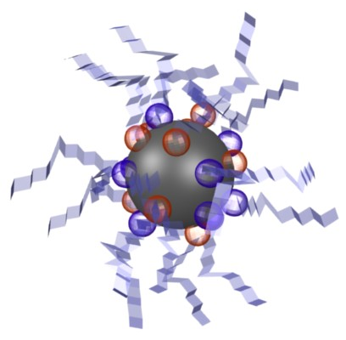
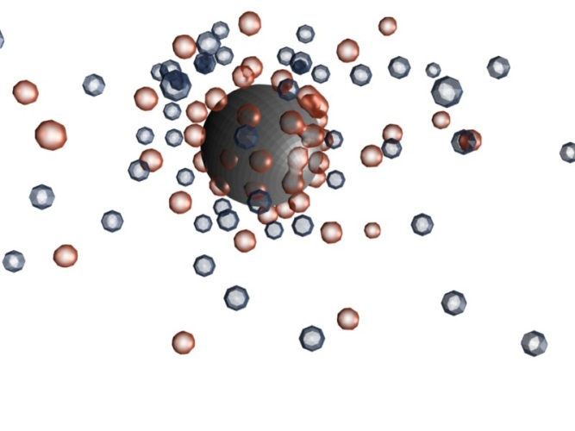
General strategy for NPs synthesis - surfactants
“Chemical approach”
Steric hindrance: polymer
L
L
X
+
L
Surfactants
Electrosteric hindrance:
surfactants
Electrostatic hindrance: charges
Ecole ETPMSE – 20/06/2016

Slide 13

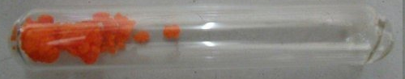
General strategy for NPs synthesis - precursor
L
L
Noble and plasmonic metal (Au, Ag, Pt, Pd) : stable in air
Easy to handle! (cf TP3)
X
L
For noble metal : various precursors can be used!.
HAuCl₄, AuCl(PPh₃), AuCl, AuBr….
Ecole ETPMSE – 20/06/2016

Slide 14
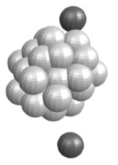
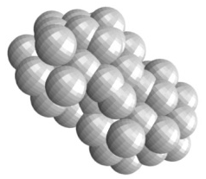
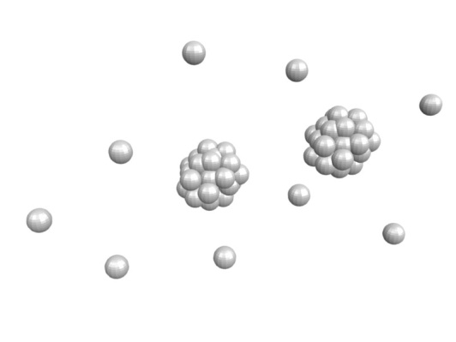
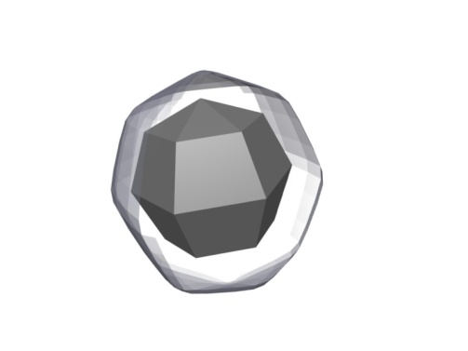
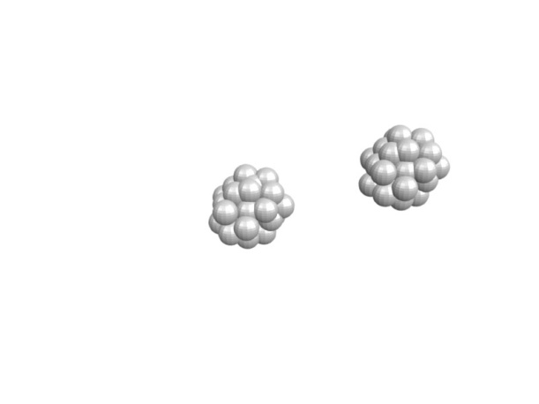

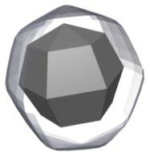
General strategy for NPs synthesis - precursor
“Chemical approach”
L
L
+ surfactants
X
L
Decomposition
Nucleation
Reducing agent, T
Growth
and/or Coalescence
seeds + atoms
Colloidal solution
Ecole ETPMSE – 20/06/2016

Slide 15
General strategy for NPs synthesis – reducing agent
Oxydo-reduction potential :
E⁰ (V)
1,69V
Au⁺ Au
Pt²⁺ Pt
Noble metal : easy to reduce
Ag⁺ Ag
0,34V
Cu²⁺ Cu
Ni²⁺ Ni
Strong reducing agent needed
Issues of oxidation in air
Co²⁺ Co
-0,44V
Fe²⁺ Fe
Too difficult to reduce
Very easy to reduce : a variety of reducing agent can be used
NaBH₄, citrate, oleylamine, H₂,….
Ecole ETPMSE – 20/06/2016

Slide 16

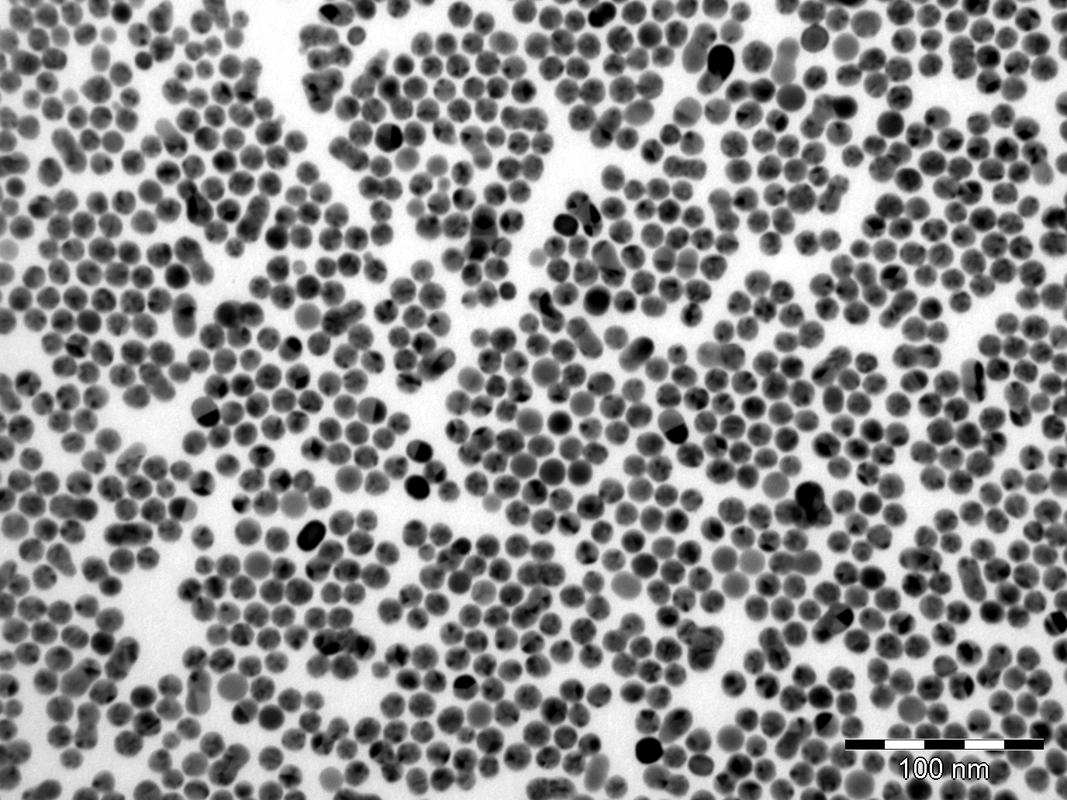
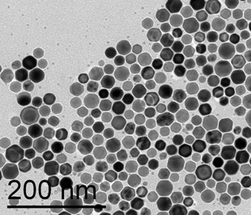
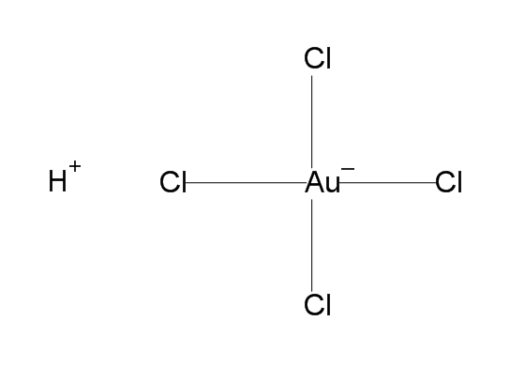
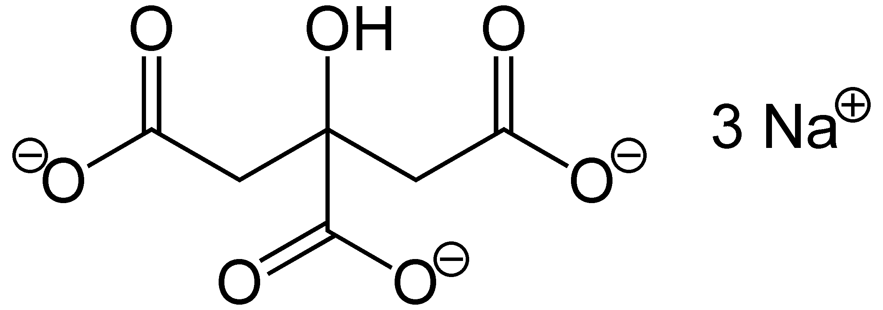
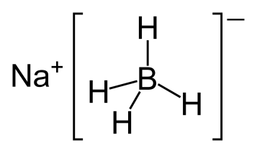
Synthesis of nanoparticles – Brust reaction
Synthesis : Reduction of a metallic salt
M^{n+} + n e⁻ M
Au
Ag
HAuCl₄
+
Sodium citrate
NaBH₄
DI water, T_{amb}
Fast reduction
Ecole ETPMSE – 20/06/2016

Slide 17
Nanoparticles : synthesis - applications
Chemical synthesis: brief overview
20 nm
Size and shape control
Controlled self-assemblies
Perspectives : hybrids nanoparticles
Ecole ETPMSE – 20/06/2016
Notes:
17

Slide 18
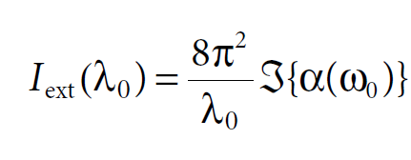
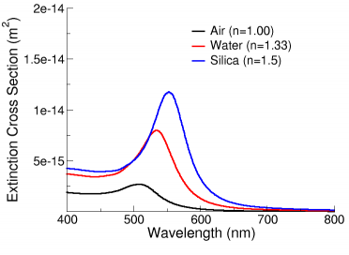
Size and shape control
A single metal particle is modeled by a polarizable sphere
which acquires a dipolar momentum.
z
E
(radius a)
y
x
E. D. Palik, Handbook of Optical Constants of Solids, Academic,
San Diego, CA 1998.

Slide 19
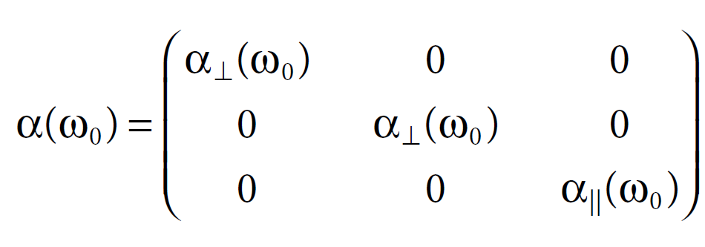
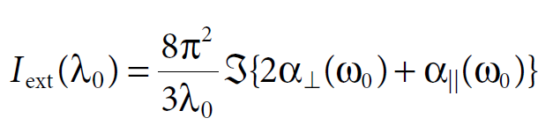
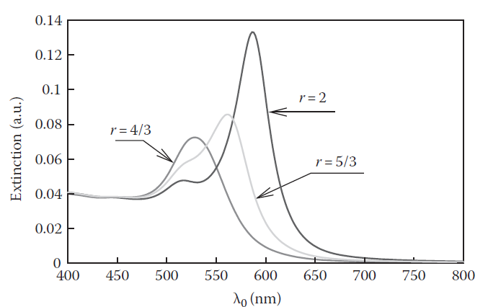
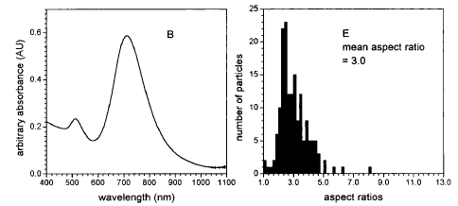
Size and shape control
For an elongated nanoparticle, the polarizability is no more scalar but a tensor.
z
Main axis a
Minor axis b
E
y
x
E. Dujardin, C. Girard, Handbook of Nanophysics, 2010, Chp 27
C. R. C. Wang et al., J. Phys. Chem. B, 1997, 101, 6661-4

Slide 20
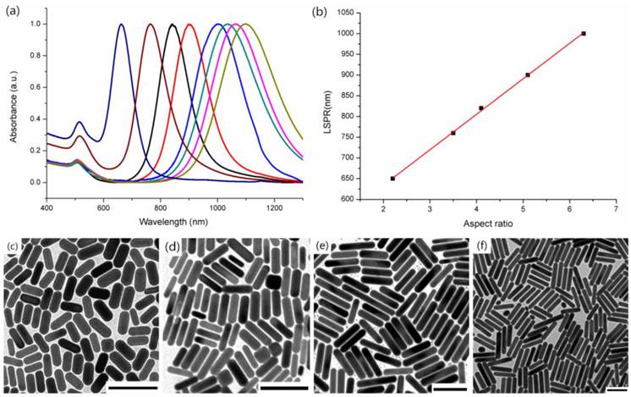
Effect of nanorod aspect ratio
Wang S, Xi W, Cai F, Zhao X, Xu Z, Qian J, He S. Theranostics 2015; 5(3):251-266

Slide 21
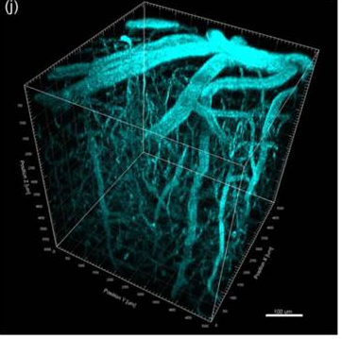
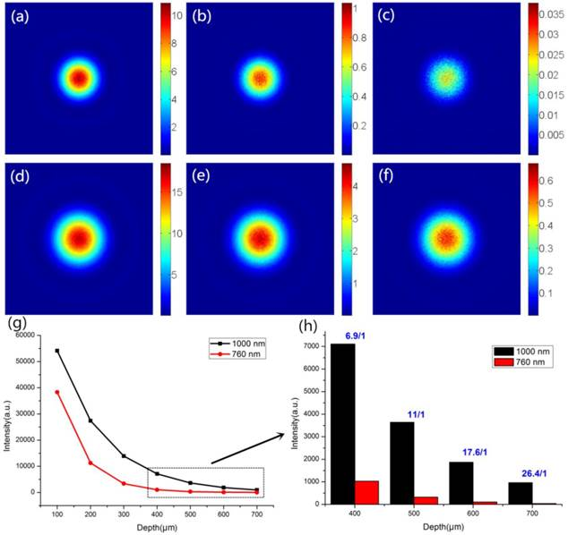
Effect of nanorod aspect ratio
Technological relevance of controlling the aspect ratio
S. Wang, W. Xi, F. Cai, X. Zhao, Z. Xu, J. Qian, S. He, Theranostics 2015; 5(3):251-266

Slide 22


Molding of nanorods in porous alumina
P Evans, W R Hendren, R Atkinson, G A Wurtz,
W Dickson, A V Zayats and R J Pollard
Nanotechnology, 2006, 17, 5746
Es-Souni M and Habouti S, Front. Mater. 2014, 1,19

Slide 23



Growth inhibition yields crystalline and faceted nanoparticles
Xia Y et al., Angew. Chem. Int. Ed., 2009, 48, 60-103.

Slide 24




Nanorods and nanowires
Nanorods
Br⁻
Br⁻
CTAB
Cetyl trimethyl ammonium bromide
Seeds: 3-4 nm
Inhibitor: C₁₆-NMe₃⁺, Br⁻ (CTAB)
Reducing agent: Ascorbic acid
Typical length: 400 nm
<112> + <100>
A (1-11)
B (311)
C (220)
a (-200)
b (020)
C (220)
Zipping mechanism
J. Gao, C. M. Bender, C. J. Murphy, Langmuir 2003, 19, 9065–9070
C. Johnson, et al., J. Mater. Chem., 2002, 12, 1765

Slide 25




Nanoprisms and microplatelets
Nanoprisms
PVP
Poly-vinyl pyrrolidone
Seeds: no no
Inhibitor: PVP PVP/NO₃⁻
Reducing agent: PVP PVP
Typical size: 150nm 500nm
Zipping mechanism
J. Sharma, E. Dujardin, 2016, in prep.
b
A (220)
a 1/3 (422)
b (422)
a
A
20 μm
J. Sharma, E. Dujardin, 2016, in prep.
S. Bolisetty et al.,
J. Coll. Interf. Sci. 361 (2011) 90

Slide 26



An infinite playground
Marek Grzelcza et al.,
Chem. Soc. Rev., 2008,37, 1783
M. Rycenga et al., Chem. Rev. 2011, 111, 3669–3712

Slide 27

An infinite playground
Marek Grzelcza et al.,
Chem. Soc. Rev., 2008,37, 1783
G. C. Schatz,
Proc. Natl. Acad. Sci. U. S. A. 2007, 104, 688

Slide 28






Spatial engineering of plasmonic LDOS
S. Viarbitskaya, et al.,
Nature Materials, 2013, 12, 426-432
Appl. Phys. Lett. 2013, 103, 131112
Scale bars: 200 nm
TPL experiments

Slide 29
Nanoparticles : synthesis - applications
Chemical synthesis: brief overview
20 nm
Size and shape control
Controlled self-assemblies
Perspectives : hybrids nanoparticles
Ecole ETPMSE – 20/06/2016
Notes:
29

Slide 30

Coupled nanoparticles
Two coupled spherical particles
x
E₀
(a)
(b)
By combining E(r_{a},ω) and E(r_{b},ω) into
one vector ε(ω) (same for E₀), one gets :
With
and
All one needs is
z
R
y
C. Girard, Rep. Prog. Phys., 68, 1883 (2005)

Slide 31
Coupled nanoparticles
Transverse and longitudinal modes
x
ω₀(1+α₀/2R³)
ω₀
Transverse
Longitudinal
E₀
ω₀(1-α₀/R³)
(a)
(b)
z
R
N=8
y
N=1
With the simple analytical model:
C. Girard, Rep. Prog. Phys., 68, 1883 (2005)

Slide 32

Assembling nanoparticles
C. Polte, CrystEngComm, 2015, 17, 6809-6830

Slide 33




Plasmonic Nanoparticle Networks
Citrate-stabilized
Au NP
Mercaptoethanol (MEA)
HS-CH₂-CH₂-OH
Adv Mater 2005, 17, 2553-59
Adv. Funct. Mater. 2011, 21, 851–859
Phys Rev Lett 2006, 97, 100801
Phys Rev B 2010, 81, 153412
J. Chem. Phys., 2009 130, 03470
ACS Nano 2012, 6, 3434-40

Slide 34




Nanoparticle chains
65 nm
~1 nm
250 nm
S. J. Barrow et a;., Nano Lett. 2011, 11, 4180

Slide 35
Plasmonic Nanoparticle Networks
Adv Mater 2005, 17, 2553-59
Adv. Funct. Mater. 2011, 21, 851–859
Phys Rev Lett 2006, 97, 100801
Phys Rev B 2010, 81, 153412
J. Chem. Phys., 2009 130, 03470
ACS Nano 2012, 6, 3434-40

Slide 36



Multimodal plasmonics in fused colloidal networks
EELS imaging & spectroscopy
Delocalized modes in fused PNN
2.45 eV
1.61 eV
1.11 eV
0.38 eV
A. Teulle, M. Bosman, C. Girard, K. L. Gurunatha, M. Li, S. Mann, E. Dujardin,
Nature Materials, 2015, 14, 87

Slide 37





Nanorod chains
DMF:H₂O 6%
DMF:H₂O 20%
Z. Nie et al., Nat Mater. 2007, 6, 609

Slide 38


Fused nanorod chains
González-Rubio, G et al., Nano Lett. 2015, 15, 8282

Slide 39






Templated 2D assembly
Capillary force assisted assembly
Long-range coupling of LSP modes
T. Jägeler-Hoheisel, et al.
J. Phys. Chem. C, 2013, 117, 23126−23132

Slide 40






Templated 2D assembly
Polarization dependency
Modal & spatial extension of coupled LSP
h = 150 nm
h = 120 nm
h = 101 nm
diameter = 100 nm
T. Jägeler-Hoheisel, et al.
J. Phys. Chem. C, 2013, 117, 23126−23132

Slide 41
Nanoparticles : synthesis - applications
Chemical synthesis: brief overview
20 nm
Size and shape control
Controlled self-assemblies
Perspectives : hybrids nanoparticles
Ecole ETPMSE – 20/06/2016
Notes:
41

Slide 42



Synthesis of hybrids NPs
Can we combine several properties within the same object?
Alloy
Dumbbell
Core-Shell
Ecole ETPMSE – 20/06/2016

Slide 43


Synthesis of hybrids NPs
Dumbbell
Successive synthesis in organic phase
H. Yu et al., Nanolett. 5, 379 (2005)
Ecole ETPMSE – 20/06/2016

Slide 44



Synthesis of hybrids NPs : Au+Fe₃O₄
Application : Target-specific cis-platin delivery
Au 8nm, Fe₃O₄ 14nm
Herceptin
(cell targeting)
Cis-platin
(treatment)
Combination of 2 types of surface chemistry….
C. Xu et al., J. Am. Chem. Soc. 131, 4216 (2009)
Ecole ETPMSE – 20/06/2016

Slide 45


Synthesis of hybrids NPs : Au+Fe₃O₄
Au 3nm, Fe₃O₄ 14nm
Au 8nm, Fe₃O₄ 14nm
Combination of plasmonic and magnetic properties….
Can we improve the properties?
Ecole ETPMSE – 20/06/2016
H. Yu et al., Nanolett. 5, 379 (2005)

Slide 46



Synthesis of hybrids NPs : M@Au
+Au
Hetero-epitaxy growth of Au islands
F. Wetz et al., Angew. Chem. Int. Ed 46, 7079 (2007)
Ecole ETPMSE – 20/06/2016

Slide 47

Synthesis of hybrids NPs : M@Au
+Au
Hetero-epitaxy growth of Au islands
F. Wetz et al., Angew. Chem. Int. Ed 46, 7079 (2007)
Ecole ETPMSE – 20/06/2016

Slide 48




Synthesis of hybrids NPs : Co@Au
Addition of a wetting layer : Sn
S. Lentijo et al., ACS Nano, 9, 2792 (2015)
Ecole ETPMSE – 20/06/2016

Slide 49


Synthesis of hybrids NRs : Co@Au
Good magnetic and plasmonic properties
Chemical stability
S. Lentijo et al., ACS Nano, 9, 2792 (2015)
Ecole ETPMSE – 20/06/2016

Slide 50


Synthesis of hybrids NRs : Co@Au
Aim : new biodetection based on magnetic/plasmonic NRs
A. Schrittwieser et al. ACS Nano, 6, 791 (2012)
A. Schrittwieser et al. ACS Appl. Matter Interf., 8, 8893 (2016)
Ecole ETPMSE – 20/06/2016

Slide 51




Synthesis of ultrathin Au NWs : electronic transport
HAuCl₄ + 40 Oleylamine + 100 TIPS
Hexane, 40°C
2µm
Oleylamine
Triisopropylsilane
d = 1.7 nm; l = 3 µm
Quantification phenomena ?
H. Feng et al. Chem Comm. 15, 1984 (2009)
A. Loubat et al. Langmuir, 30, 4005 (2014)
Ecole ETPMSE – 20/06/2016

Slide 52




Single Au NWs connection
Nanoxerography technique
    a) Charge injection by AFM in PMMA electret
    b) Immersion in the colloidal solution
    c) Washing : NPs trapped on the charged patterns
Motif -5V
Au NWs :
Negatively charged
in hexane!
First assembly of anisotropic NPs!
P. Moutet et al. Langmuir, 31, 4106 (2015)
Ecole ETPMSE – 20/06/2016

Slide 53
Single Au NWs connection
Fine tuning of the charge injection
KFM
AFM
1.5V
5 nm
0V
0 nm
P. Moutet et al. Langmuir, 31, 4106 (2015)
Ecole ETPMSE – 20/06/2016

Slide 54

Au NWs instability
Raul Arenal - INA
L.-M. Lacroix et al. J. Am. Chem. Soc. 136, 13075 (2014)
Ecole ETPMSE – 20/06/2016

Slide 55





Au NWs instability : single chain formation
a)
b)
b)
L.-M. Lacroix et al. J. Am. Chem. Soc. 136, 13075 (2014)
Ecole ETPMSE – 20/06/2016

Slide 56


















Pt
Au
Pt
Au
Ge
CoPt
Co@Fe
Co@Cu

Slide 57



Synthesis of nanoparticles – Energy transfer
Heat : thermodecomposition
thermolysis
Mechanic vibration : sonolysis
Irradiation : UV decomposition
Ecole ETPMSE – 20/06/2016

Slide 58


Synthesis of hybrids NPs
Dumbbell
Synthesis in aqueous and organic phase
H. W. Gu Yu et al., J. Am. Chem. Soc. 127, 34 (2005)
Ecole ETPMSE – 20/06/2016

Slide 59


Growth mechanism : isotropic environment
10 mM HAuCl₄+ 400 mM OY + 1000 mM TIPS
Hexane
,
40°C, 1h30
Au NWs
15 min
L ~ 100 nm
45 min
L ~ 500 nm
A. Loubat et al. Langmuir, 30, 4005 (2014)
3 h
L ≥ 2 µm
Notes:
Signal plus simple
Plus gde gamme en vecteur de diffusion car SWING : plus d’info notamment les NWs

Slide 60


Growth mechanism : isotropic environment
15 min
L ~ 100 nm
45 min
L ~ 500 nm
Au NWs : yield 75%
Oriented attachment
Atom/atom growth
3 h
L ≥ 2 µm
Notes:
Signal plus simple
Plus gde gamme en vecteur de diffusion car SWING : plus d’info notamment les NWs

Slide 61


Au NWs : self assembly in solution
Expanded hexagonal superlattice
a = 9,7 nm
d = 8,0 nm = 4 * OY length
Au NWs : stabilised by
bilayers of oleylamine !
A. Loubat et al. Langmuir, 2014
Notes:
Signal plus simple
Plus gde gamme en vecteur de diffusion car SWING : plus d’info notamment les NWs

Slide 62



Au NWs : surface stabilisation
Purified Au NWs : XPS and NMR analysis
N 1s
Cl 2p
NH₃⁺
NH₂
Au NWs stabilised by bilayers :
Oleylamine (NH₂)
Oleylammonium chloride (NH₃⁺, Cl⁻)

Slide 63

Romuald
Poteau
Au NWs : “zip mechnanism” in micelles
Theoretical simulations
Oleylammonium chloride (NH₃⁺, Cl⁻)
at the surface : charges backbone?
Gao, J.; Bender, C. M.; Murphy, C. J. Langmuir 19, 9065 (2003)
A. Loubat et al. J. Phys. Chem. C 119, 4422 (2015)

